Slide 1
Digital Portfolio
STUDENT NAME : RITHISH S
REGISTER NO AND NMID : 35524U09031 & 70544D60F3F73D8914F45AB0C4128A23
DEPARTMENT : BCA-II
COLLEGE: COLLEGE/ UNIVERSITY : GOVERNMENT ARTS AND
SCIENCE COLLEGE
TIRUPATTUR / THIRUVALLUVAR

Slide 2
PROJECT TITLE
Medical Management System And BIlling

Slide 3


AGENDA
Problem Statement
Project Overview
End Users
Tools and Technologies
Portfolio design and Layout
Features and Functionality
Results and Screenshots
Conclusion
Github Link
3/21/2024 Annual Review

Slide 4

PROBLEM STATEMENT
Managing patient records, appointments, billing, and staff details
manually is time-consuming, error-prone, and inefficient. Clinics and
hospitals need a digital solution to streamline operations and improve patient care.

Slide 5

PROJECT OVERVIEW
The Medical Practice Management System is a web-based platform developed using React, TypeScript, and Tailwind.
It provides doctors, staff, and administrators with tools to manage appointments, patient records, billing, and reports efficiently

Slide 6

WHO ARE THE END USERS?
Doctors – View patient history, appointments, and prescriptions.
Patients – Book appointments, access reports, and receive notifications.
Administrative Staff – Manage billing, scheduling, and staff records.
Clinic/Hospital Management – Monitor performance with anatics.

Slide 7

TOOLS AND TECHNIQUES
Frontend: React, TypeScript, Tailwind CSS
Build Tool: Vite
Icons & UI Enhancements: Lucide React
Linting & Formatting: ESLint, TypeScript ESLint
Other Tools: PostCSS, Autoprefixer

Slide 8
POTFOLIO DESIGN AND LAYOUT
Clean, modern UI with responsive design.
Intuitive navigation for patients and doctors.
Dashboard with quick access to appointments, billing, and reports.
Minimalist color scheme with user-friendly interactions.
8

Slide 9
FEATUaRES AND FUNCTIONALITY
Patient registration and medical record management.
Appointment booking and scheduling.
Billing and invoice generation.
Notifications and reminders.
Reports and analytics dashboard.
Secure login and role-based access.

Slide 10
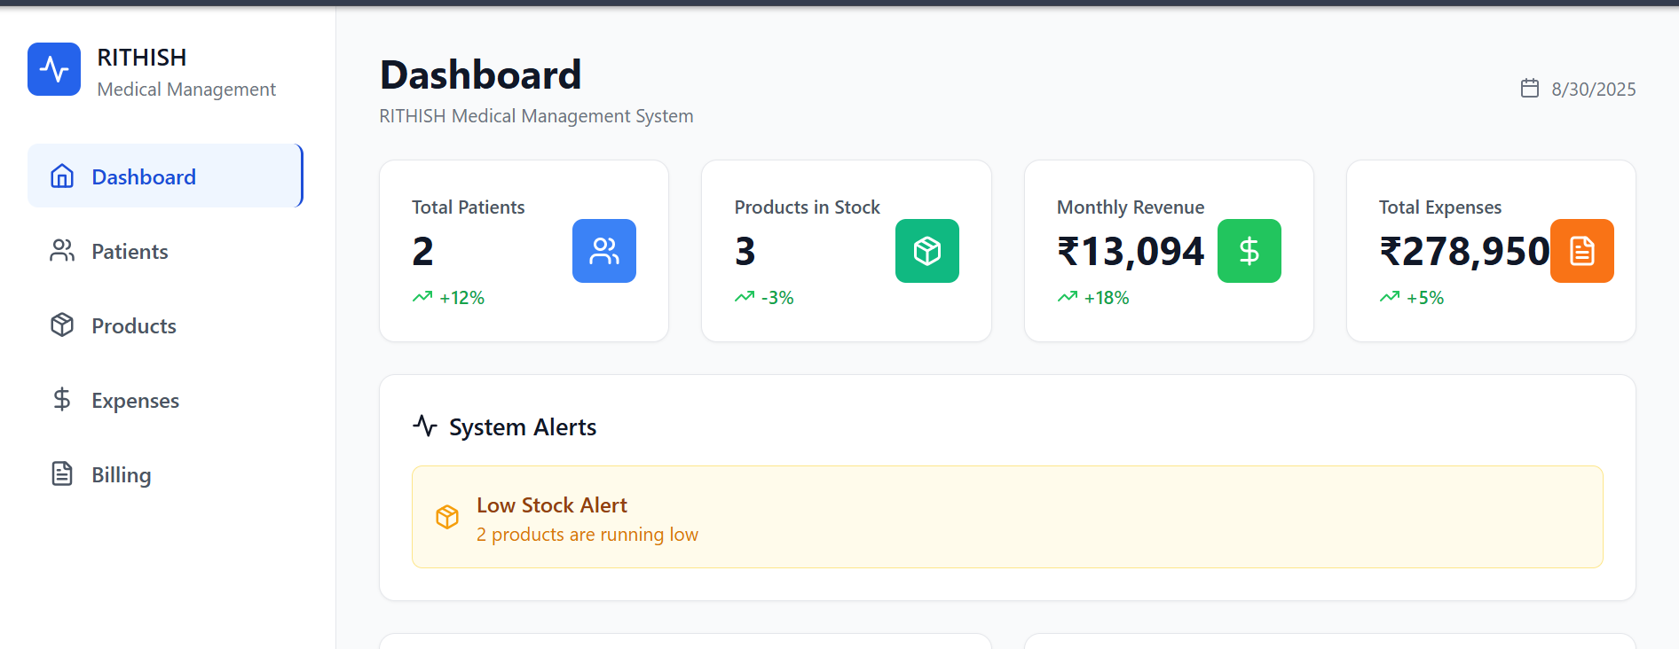

RESULTS AND SCREENSHOTS
Demonstrates successful patient registration and appointment flow.
Dashboard showcasing billing, appointments, and analytics.
Responsive views for mobile, tablet, and desktop.
3/21/2024 Annual Review
10

Slide 11
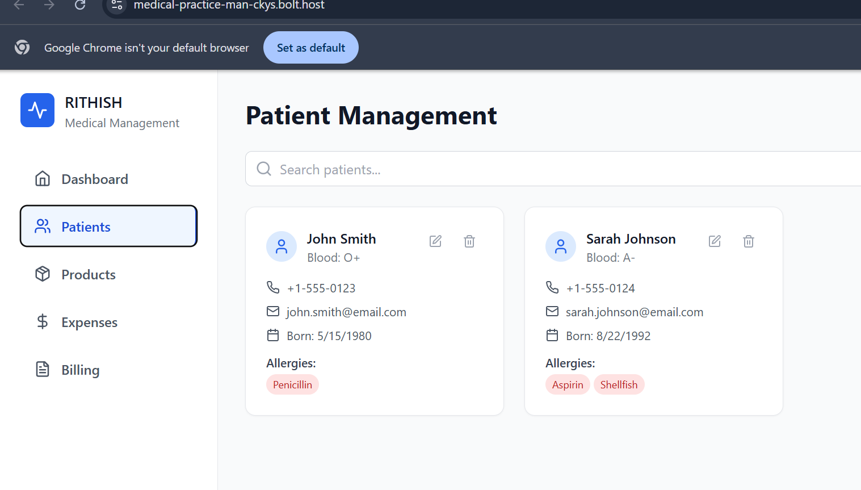
RESULTS

Slide 12
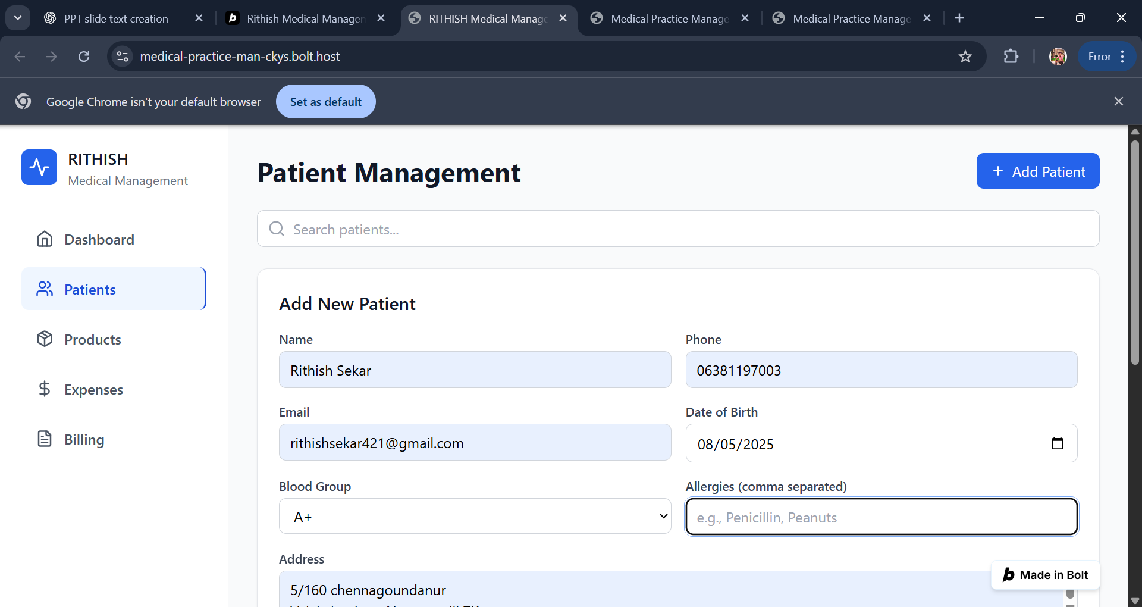
RESULTS

Slide 13
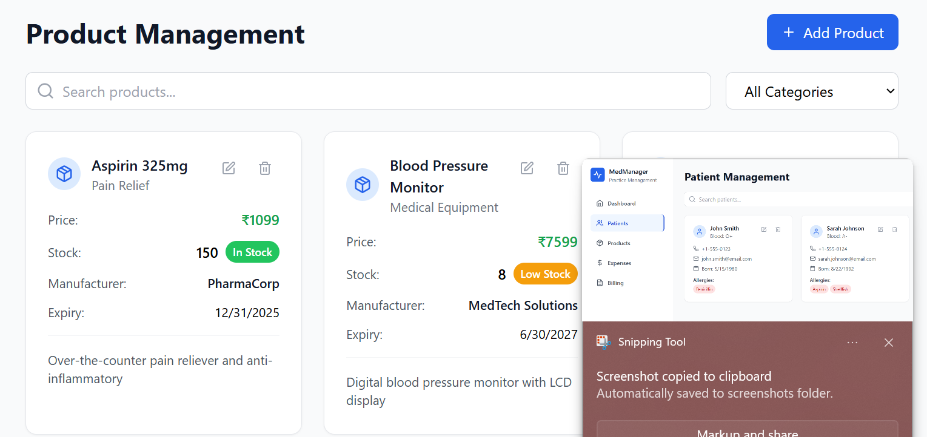
RESULTS

Slide 14
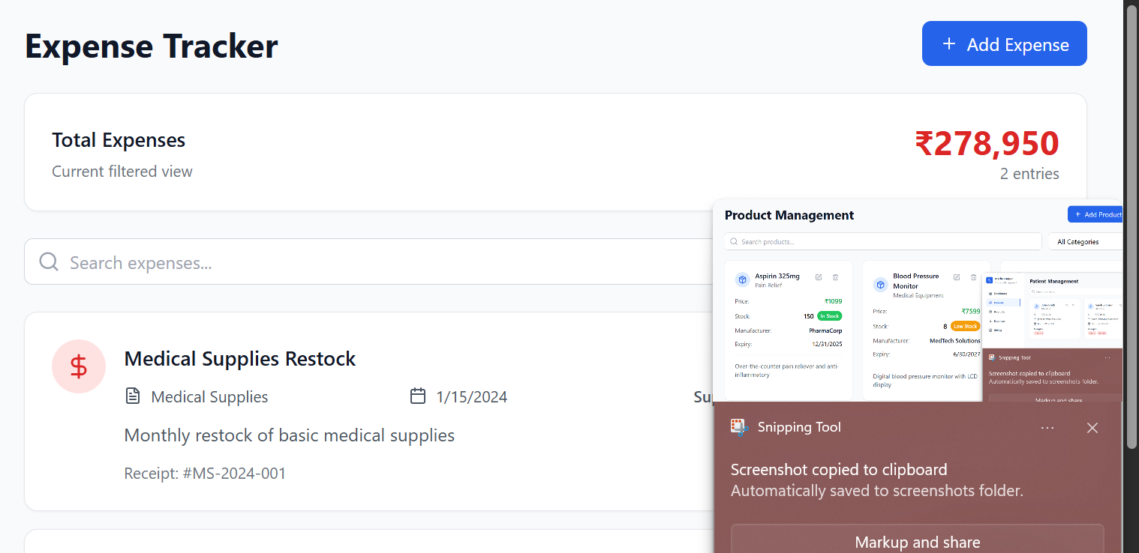
RESULTS

Slide 15
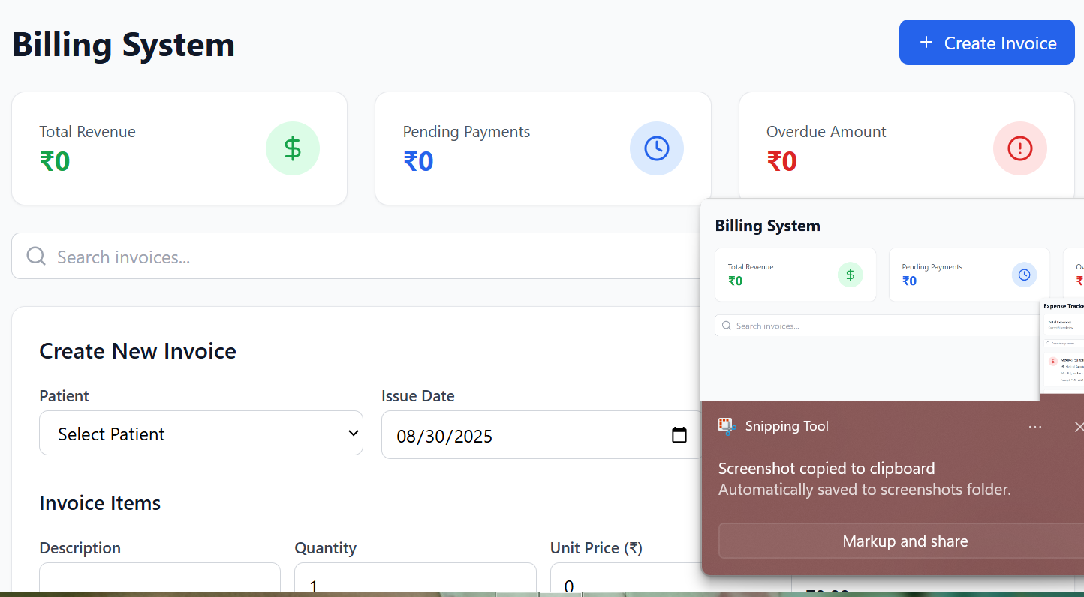
RESULTS

Slide 16
CONCLUSION
The Medical Practice Management System simplifies healthcare administration, improves patient experience, and ensures efficient record management. It is scalable, secure, and adaptable for clinics of all sizes.
16

Slide 17
GITUP LINK
https://github.com/RITHISHSNM2025/RITHISH-PPT-FWD-TNSDC-2025.git
17

